Slide 1
Azure DB for PostgreSQL Backup & Restore Demo
Sridhar Kothalanka (CSA-Data&AI)
Jan 2020

Slide 2
Single server backup and restore using “Locally Redundant” backup option

Slide 3
Create an Azure DB for PostgreSQL resource

Slide 4
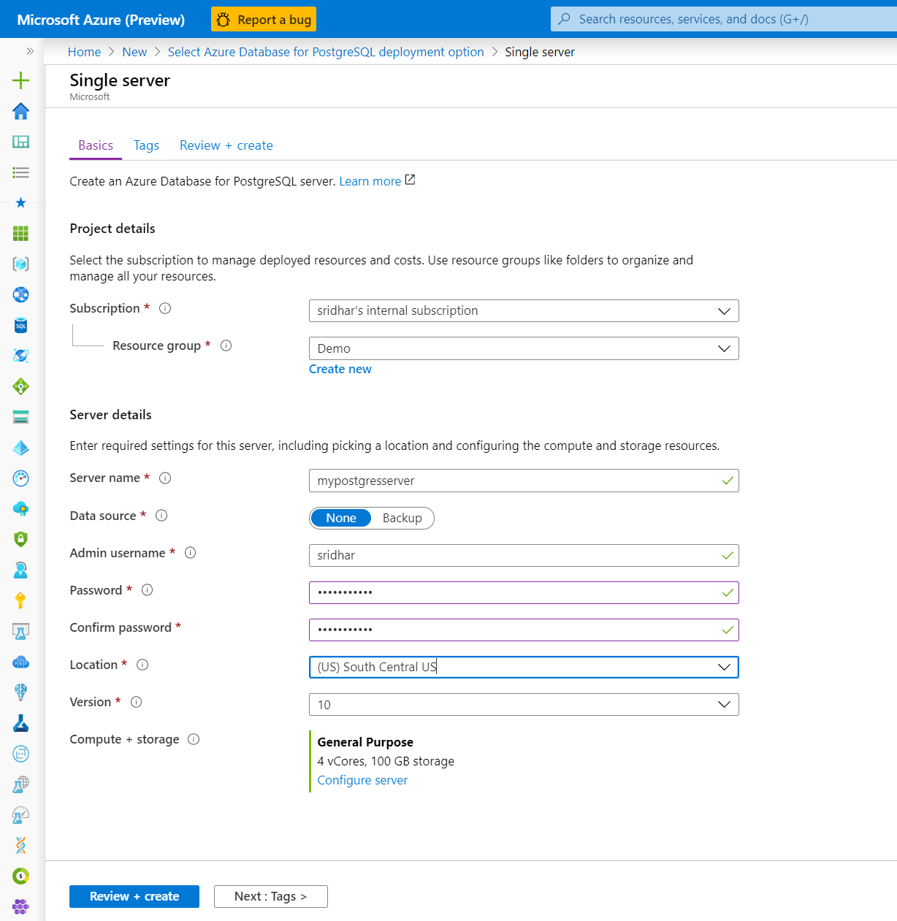
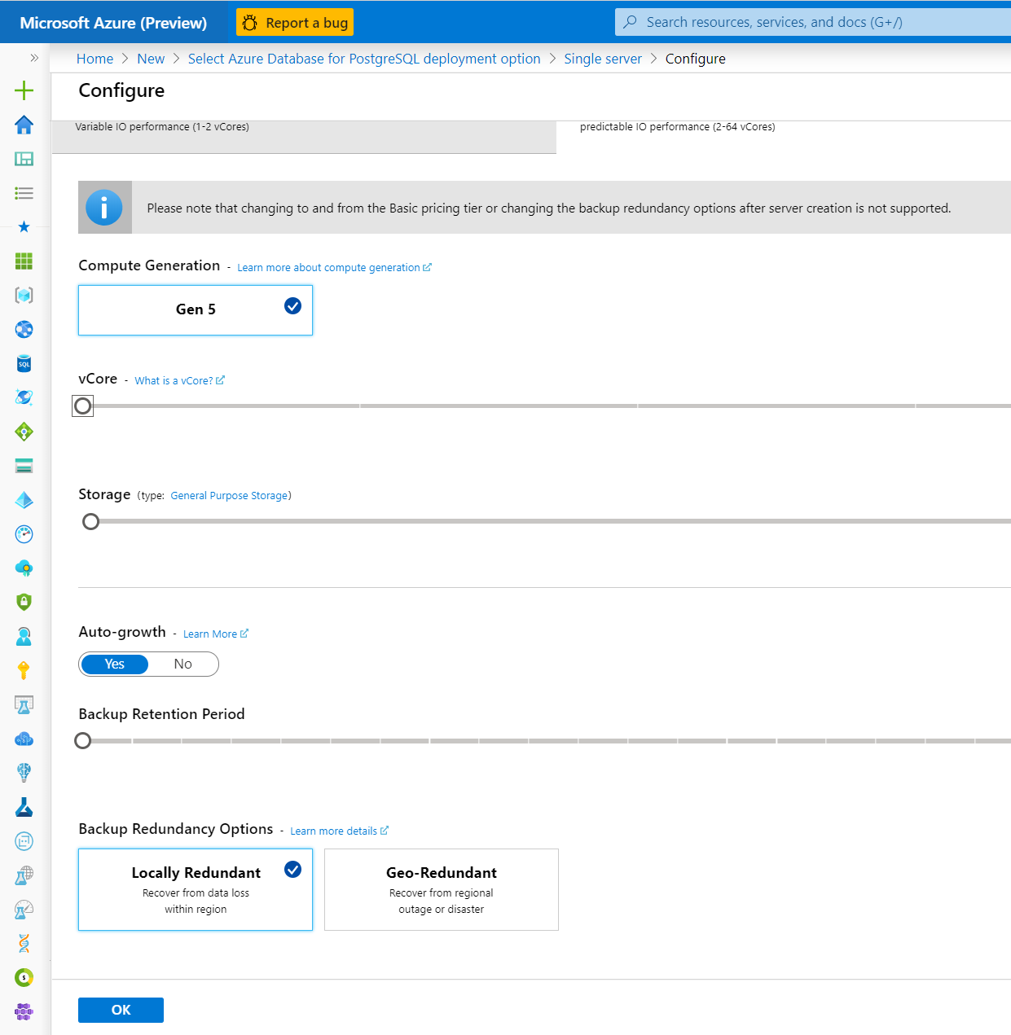
Pick the locally redundant server option
Cannot be changed once server is created
Click on configure server to choose backup option

Slide 5
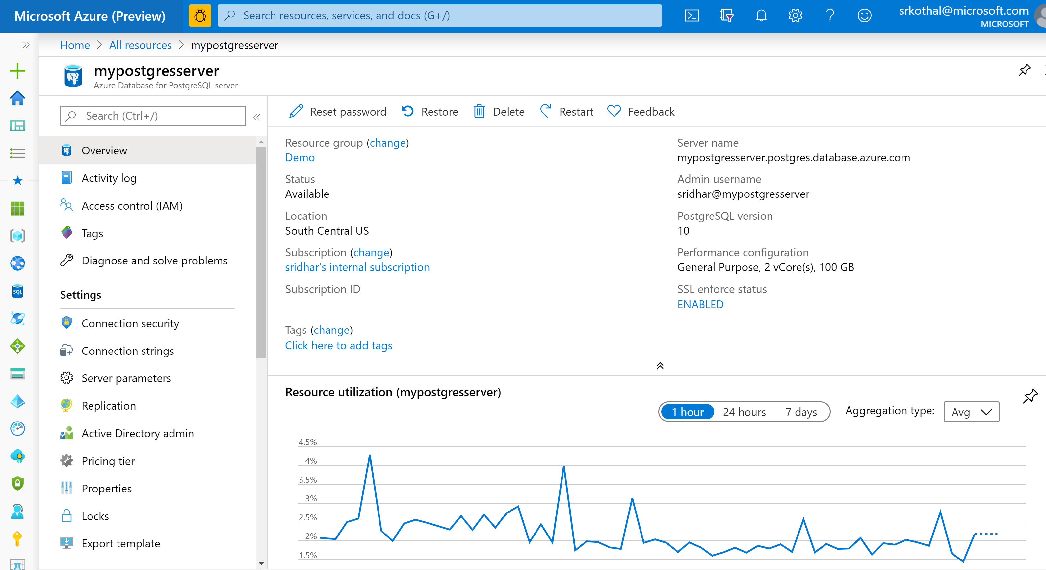
Note Server name & username
Make a note of the server name and the username

Slide 6
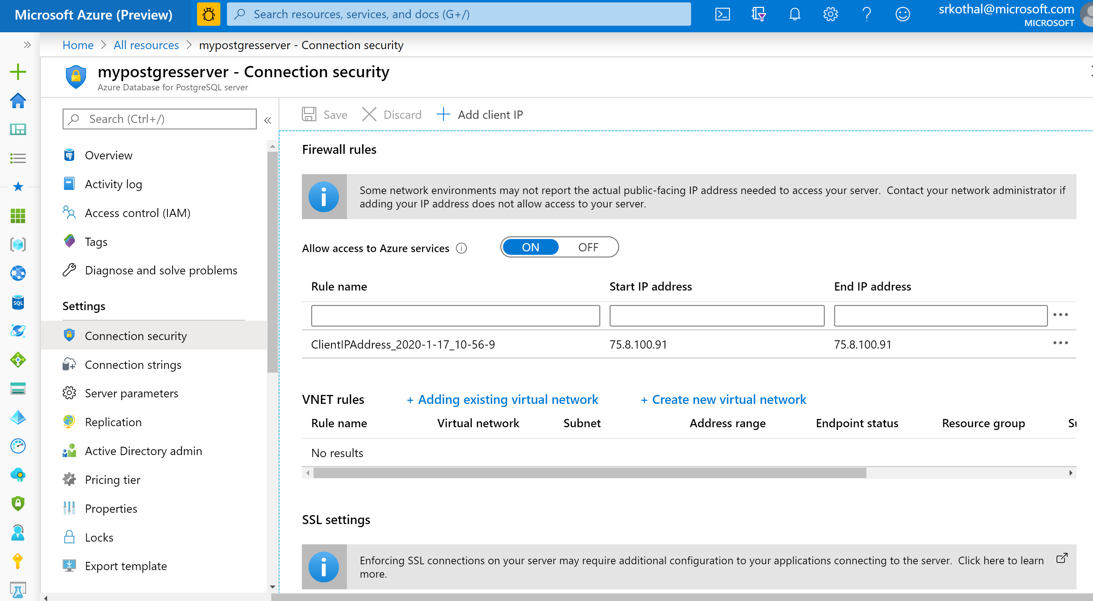
Configure the server-level firewall rule

Slide 7
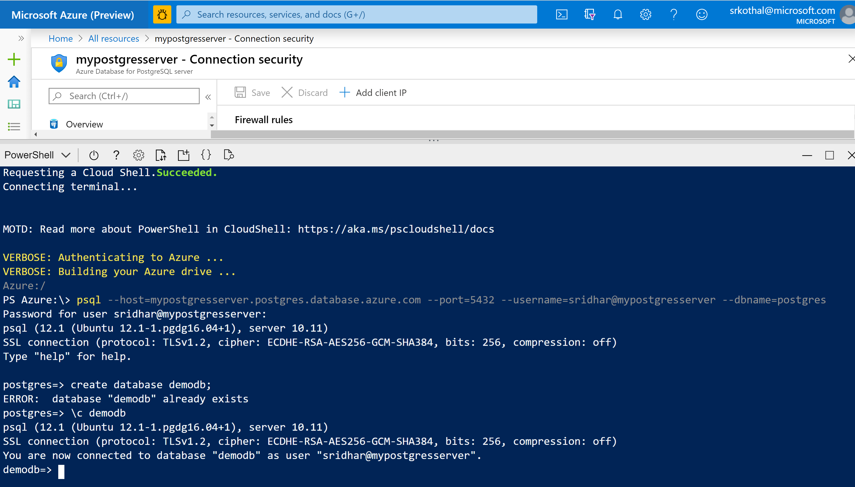
Connect to PostgreSQL server using Cloud Shell
Connect to the server
Create a database
Connect to the database

Slide 8
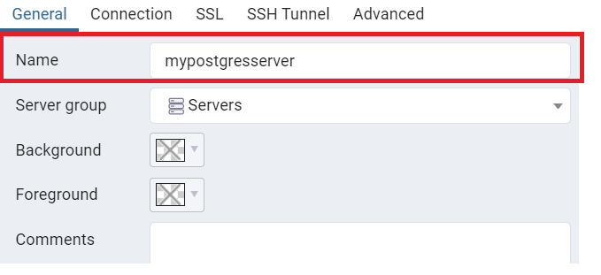
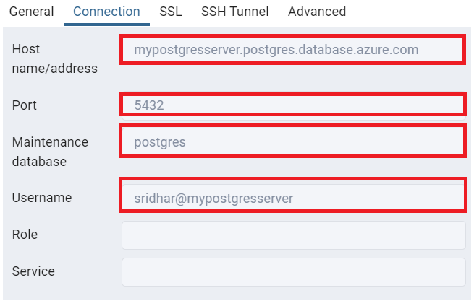
Connect using pg_admin
Launch pg_admin and add a server using the tool menu (Object -> Create -> Server…)
Input the server name in the “general” tab
Input the connection string, port, database name and username in “Connection” tab
1
2
3
Download pg_Admin and client from PostgreSQL website
https://www.enterprisedb.com/downloads/postgres-postgresql-downloads

Slide 9
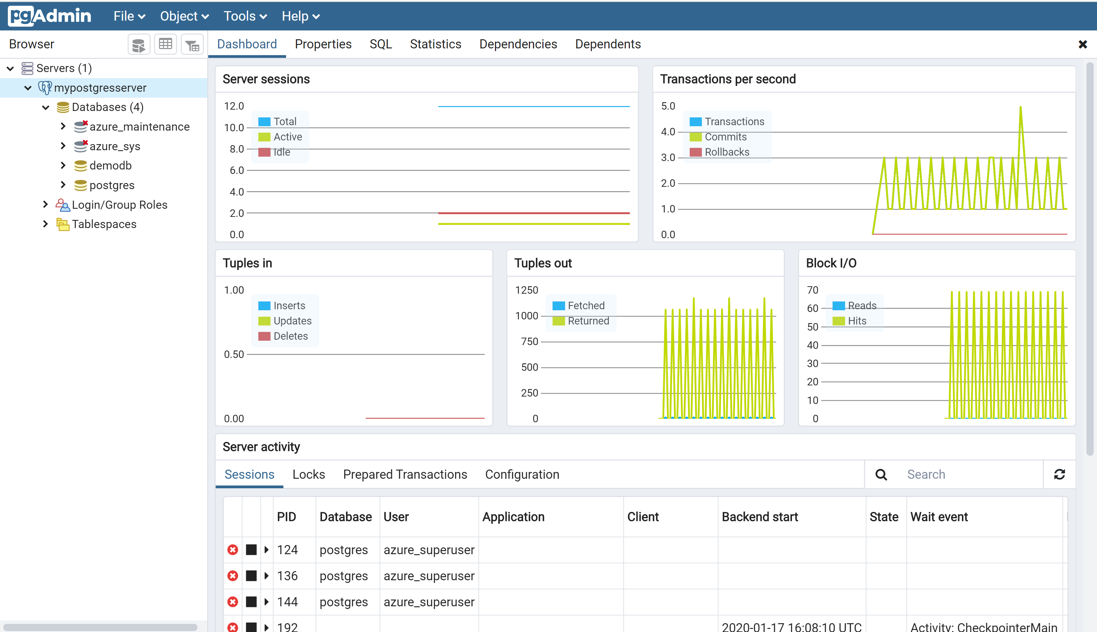
Open pg_admin client

Slide 10
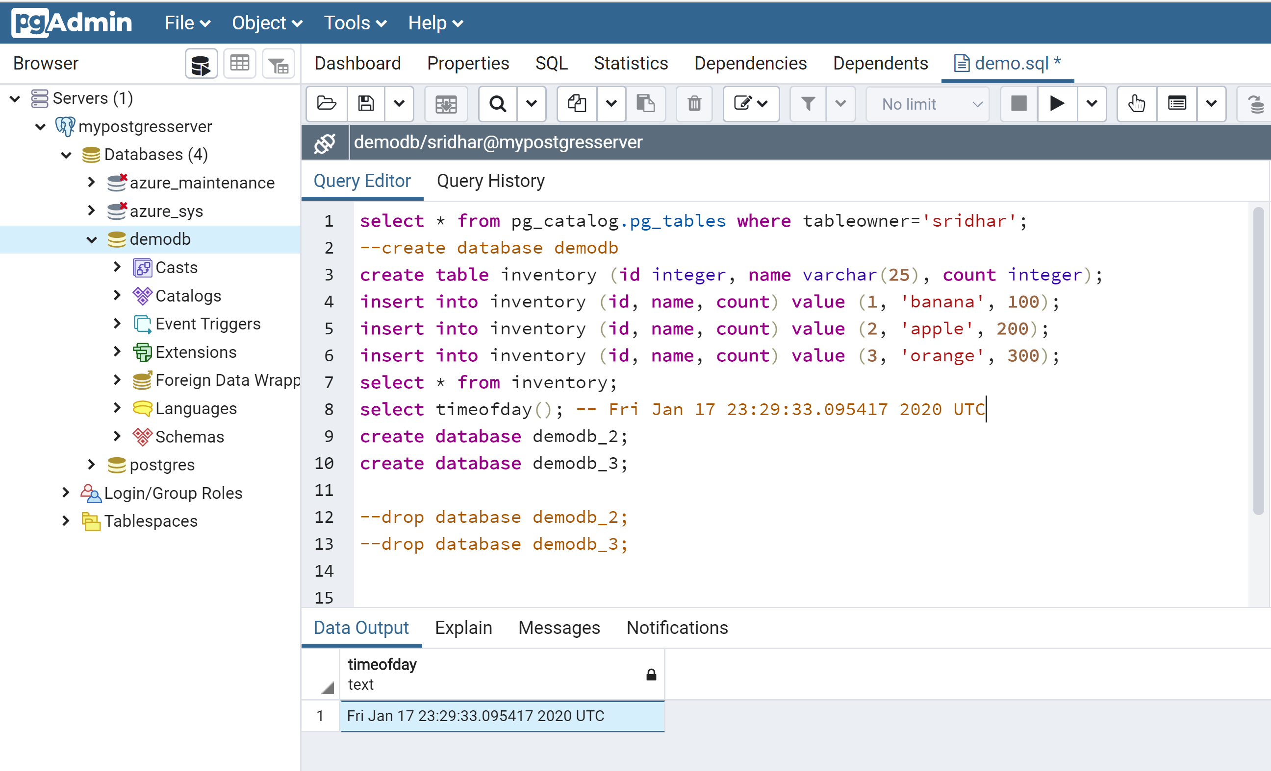
Populate the server with databases and a table
Create a table called “inventory” in demodb and populate it with 3 rows
Make a note of the timestamp. This is to capture a point in time
Create 2 additional databases
Drop the database

Slide 11
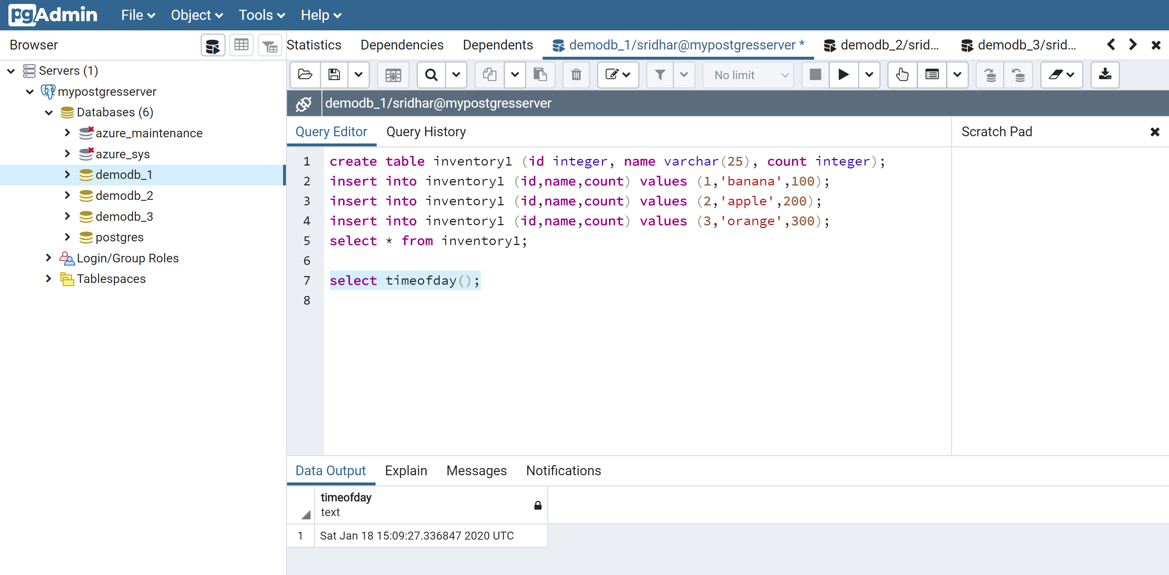
Populate the server with databases and tables
Make a note of the point-in-time when the server was healthy

Slide 12

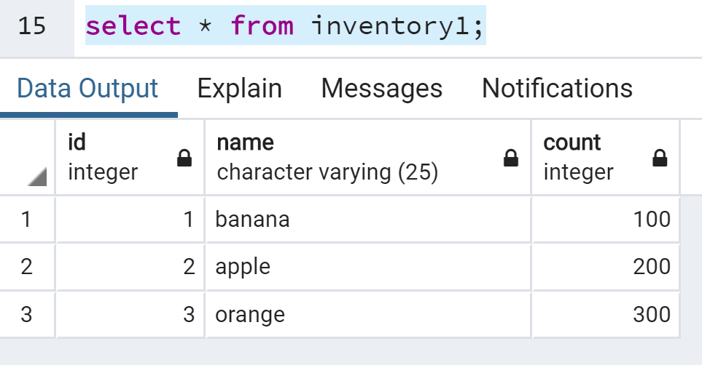
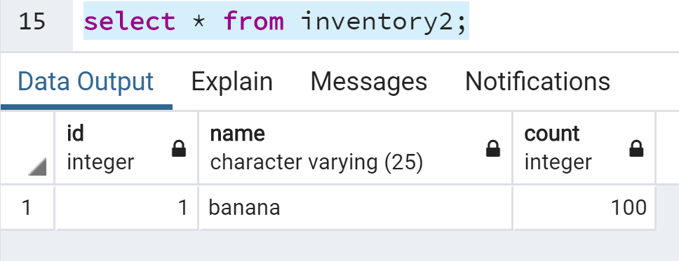
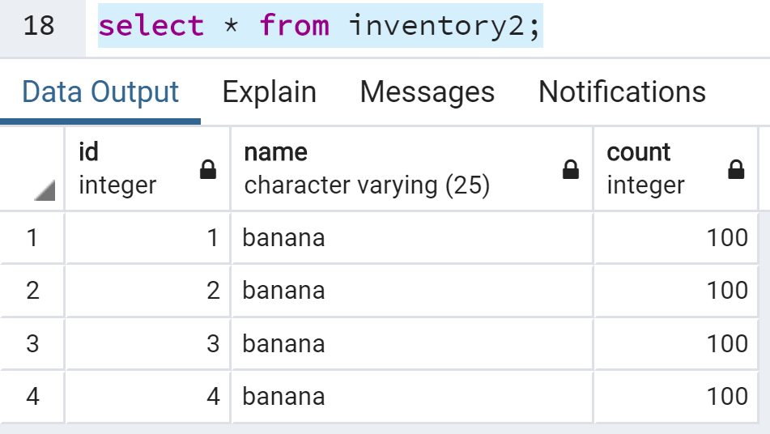
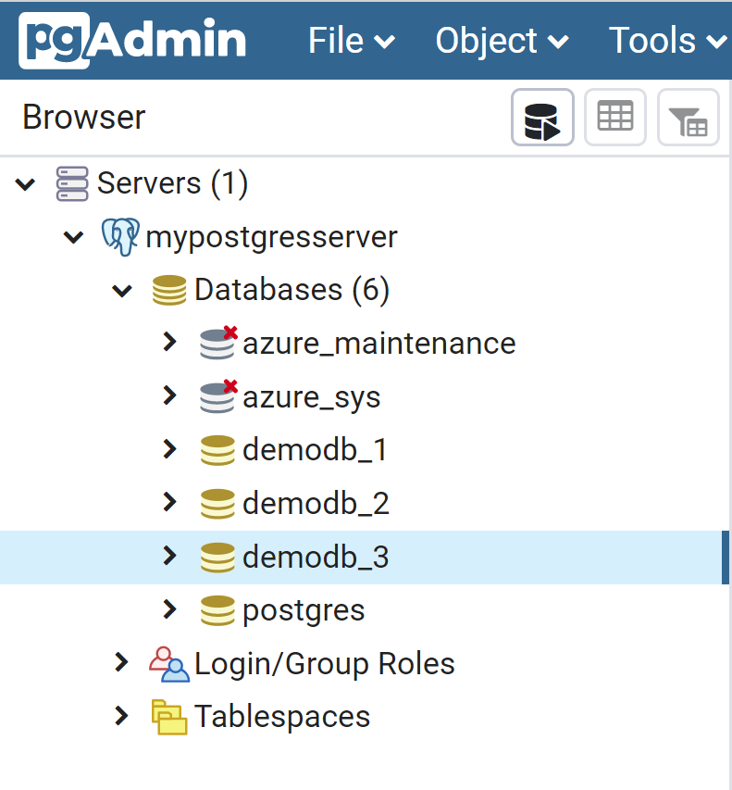
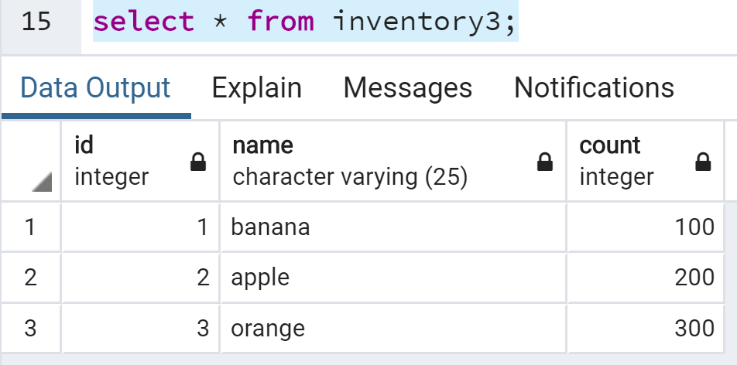
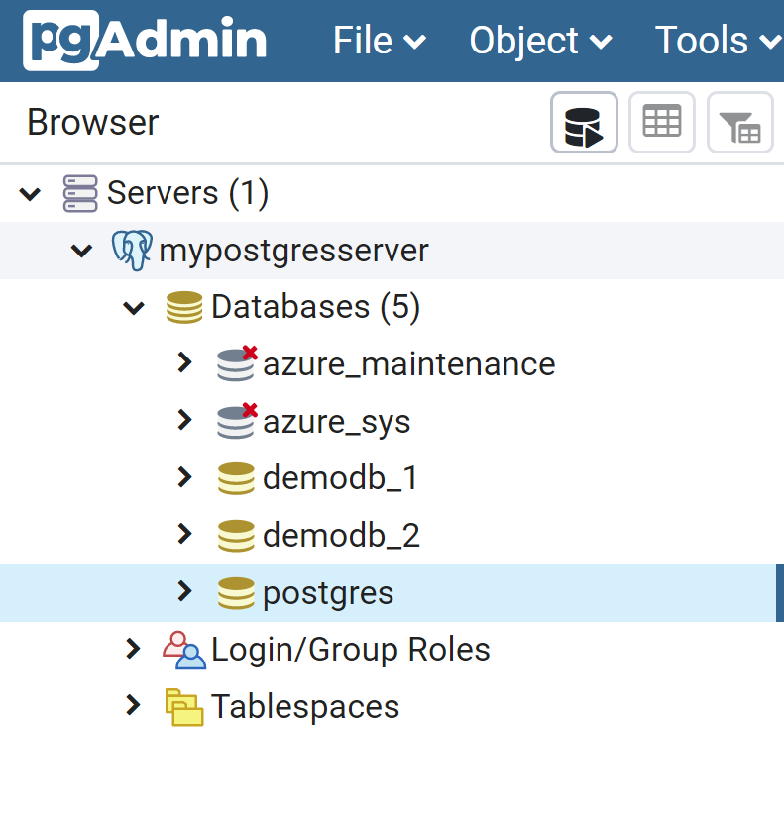
Simulate some unexpected changes
State of DB at
Database: demodb_1
Table: inventory1
Database: demodb_2
Table: inventory2
Database: demodb_3
Table: inventory3
Current state of DB
Database: demodb_1
Table: inventory1
Database: demodb_2
Table: inventory2
Database: demodb_3
Table: inventory3
Database is good to use
Inventory table should have only 1 row but has multiple rows
Database got accidentally deleted
demodb_1 inventory1 table is
good
demodb_2 inventory2
table has duplicates
demodb_3 accidentally dropped

Slide 13
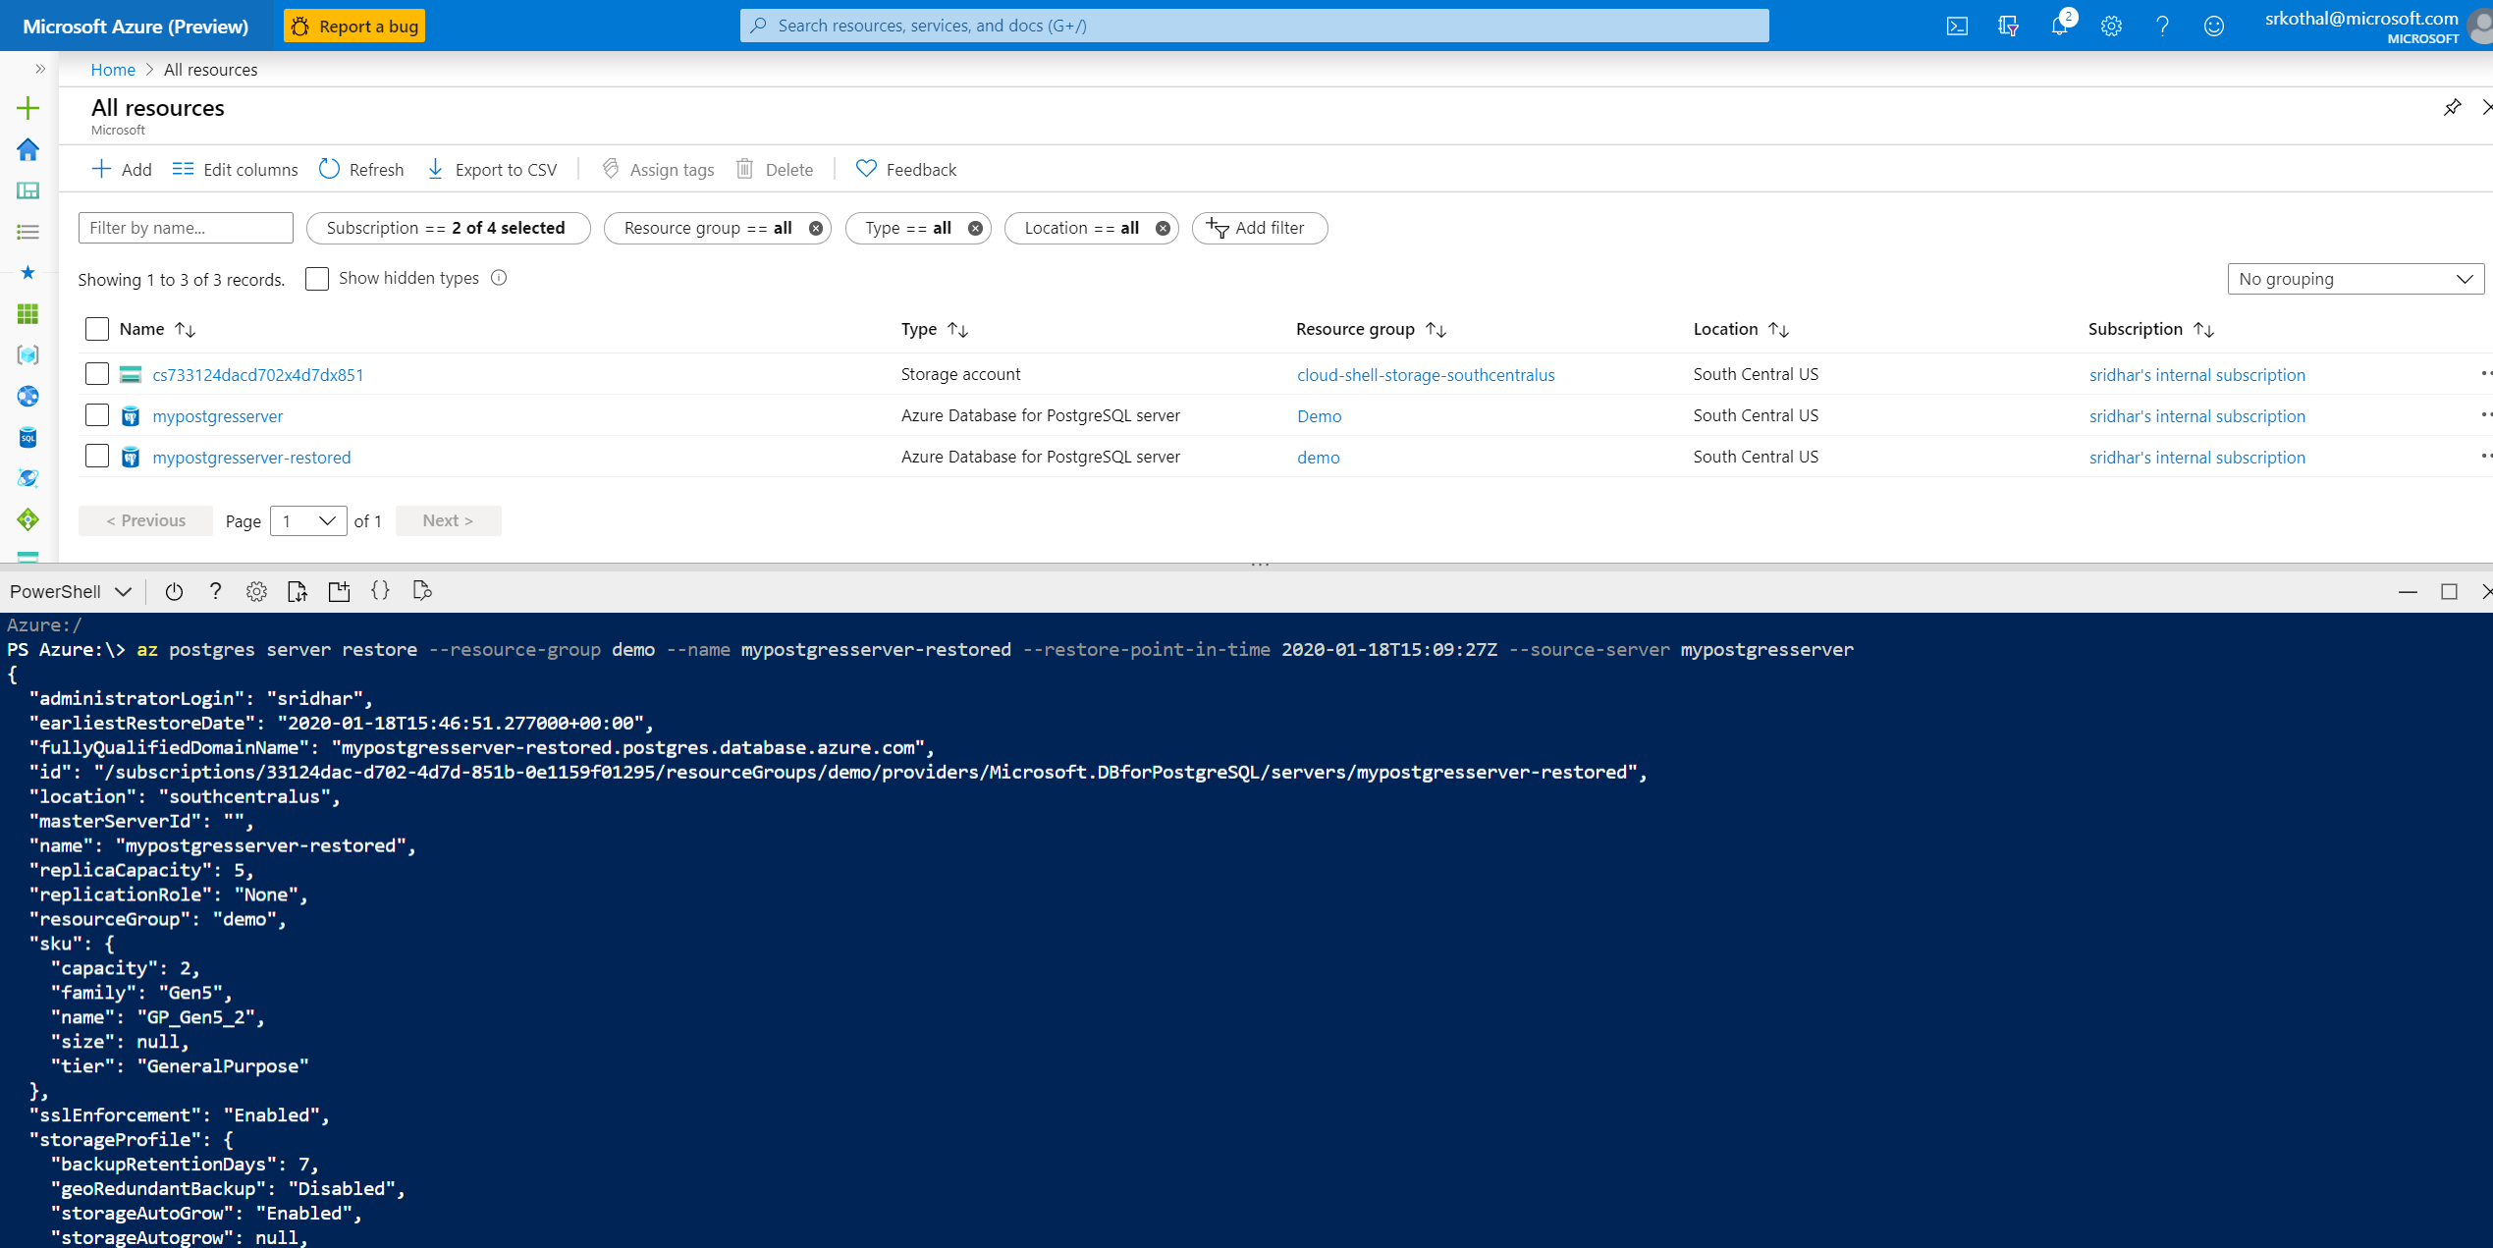
Restore the server to a point-in-time
az postgres server restore --resource-group demo --name mypostgresserver-restored --restore-point-in-time 2020-01-18T15:09:27Z --source-server mypostgresserver
1
3
4
2

Slide 14
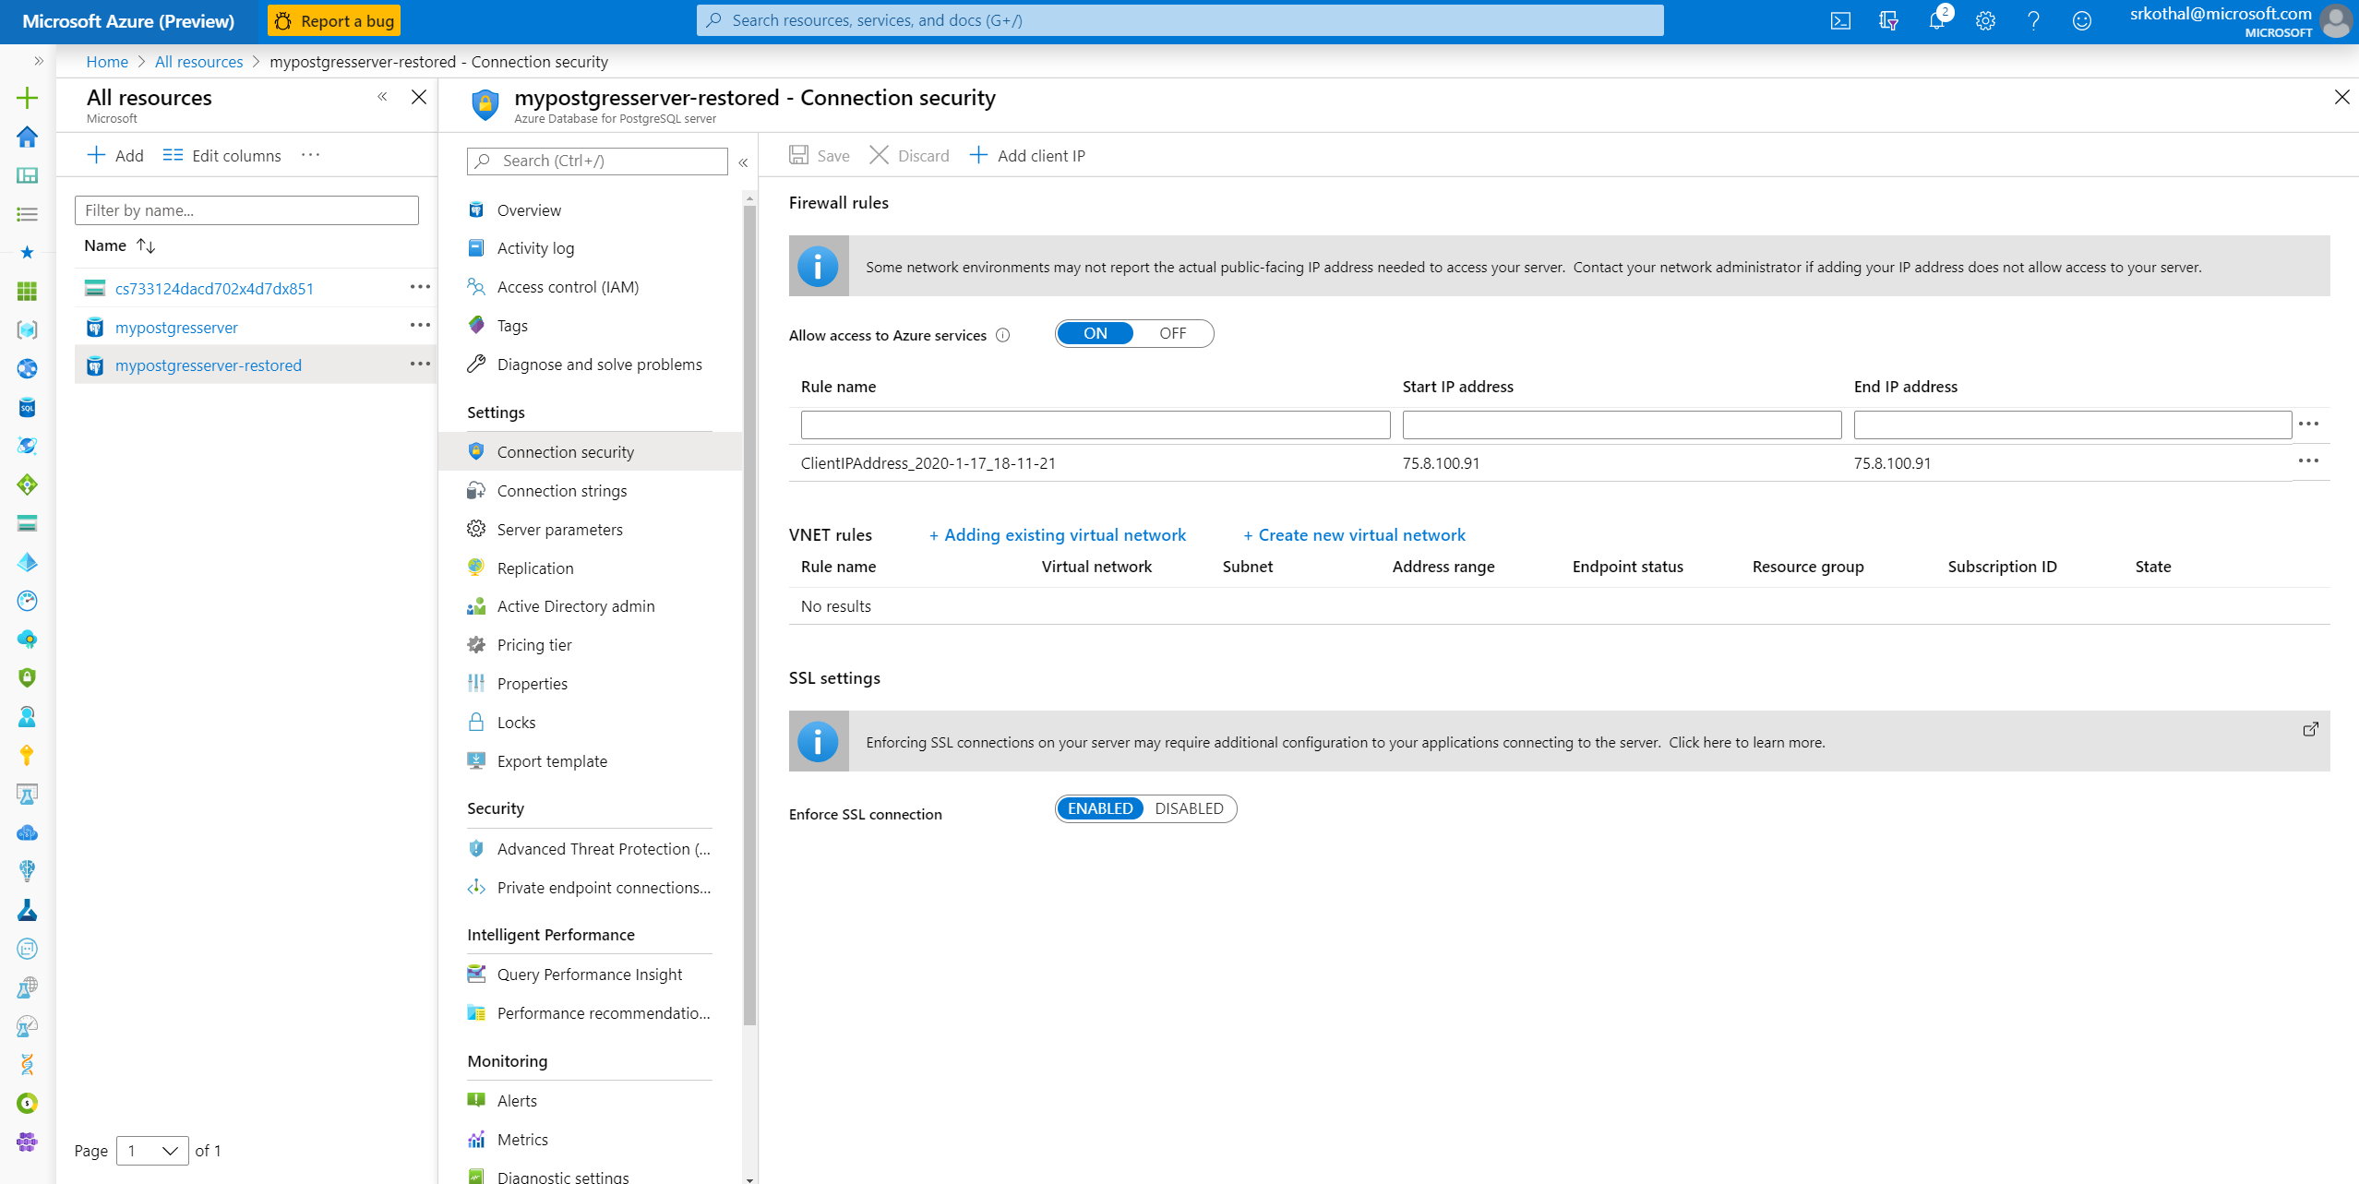
Firewall settings on the restored database

Slide 15
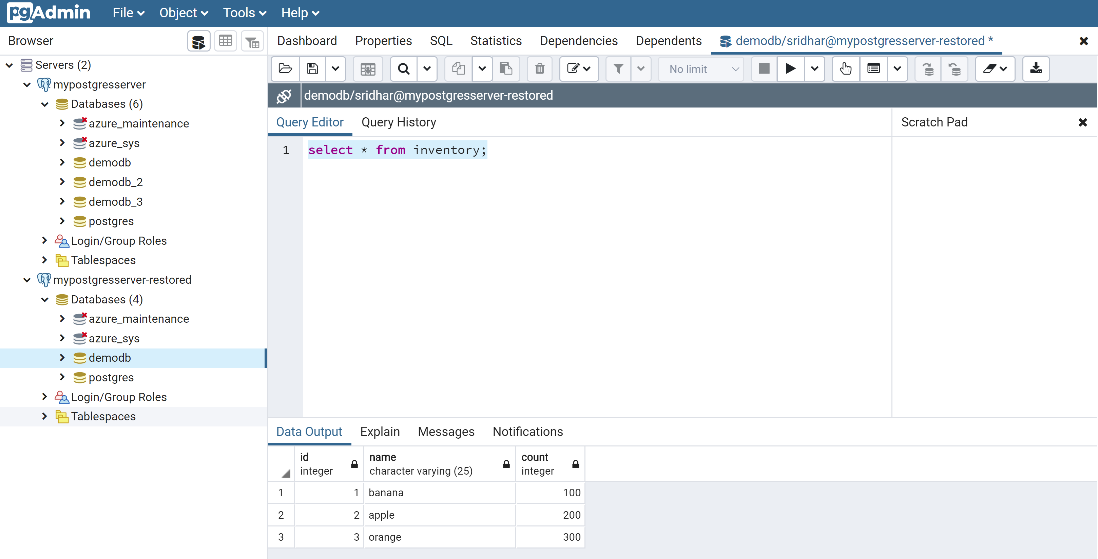
Connect to the restored database

Slide 16
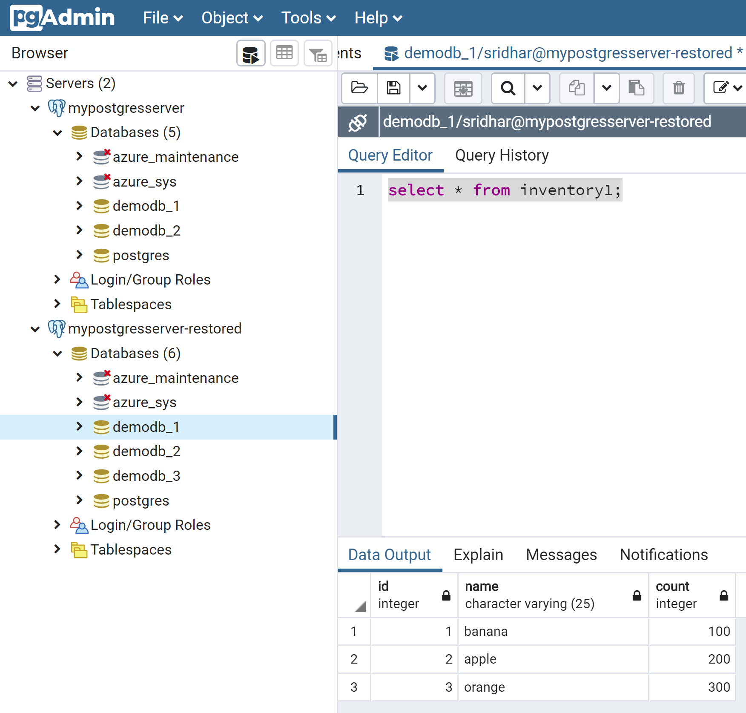
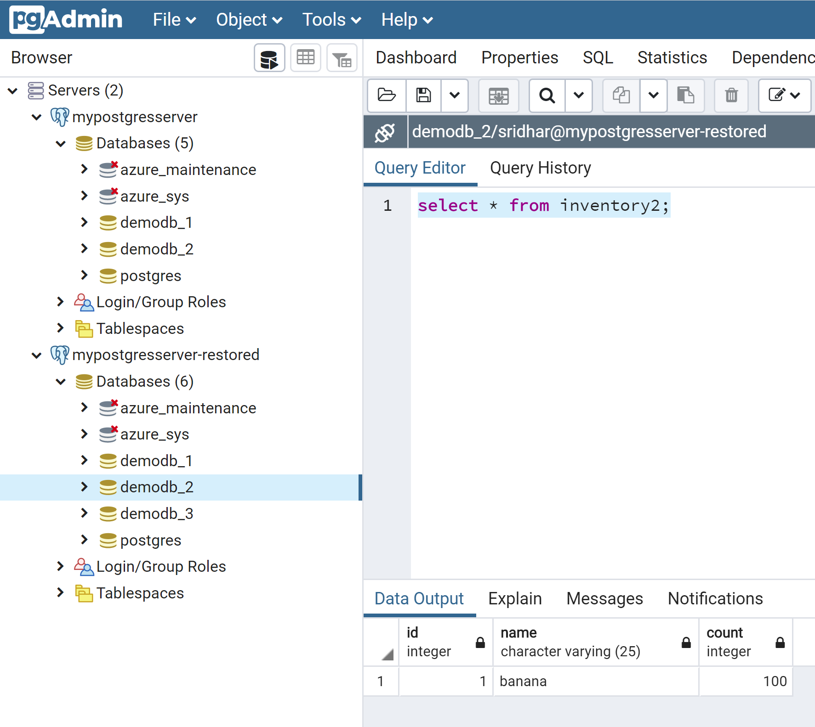
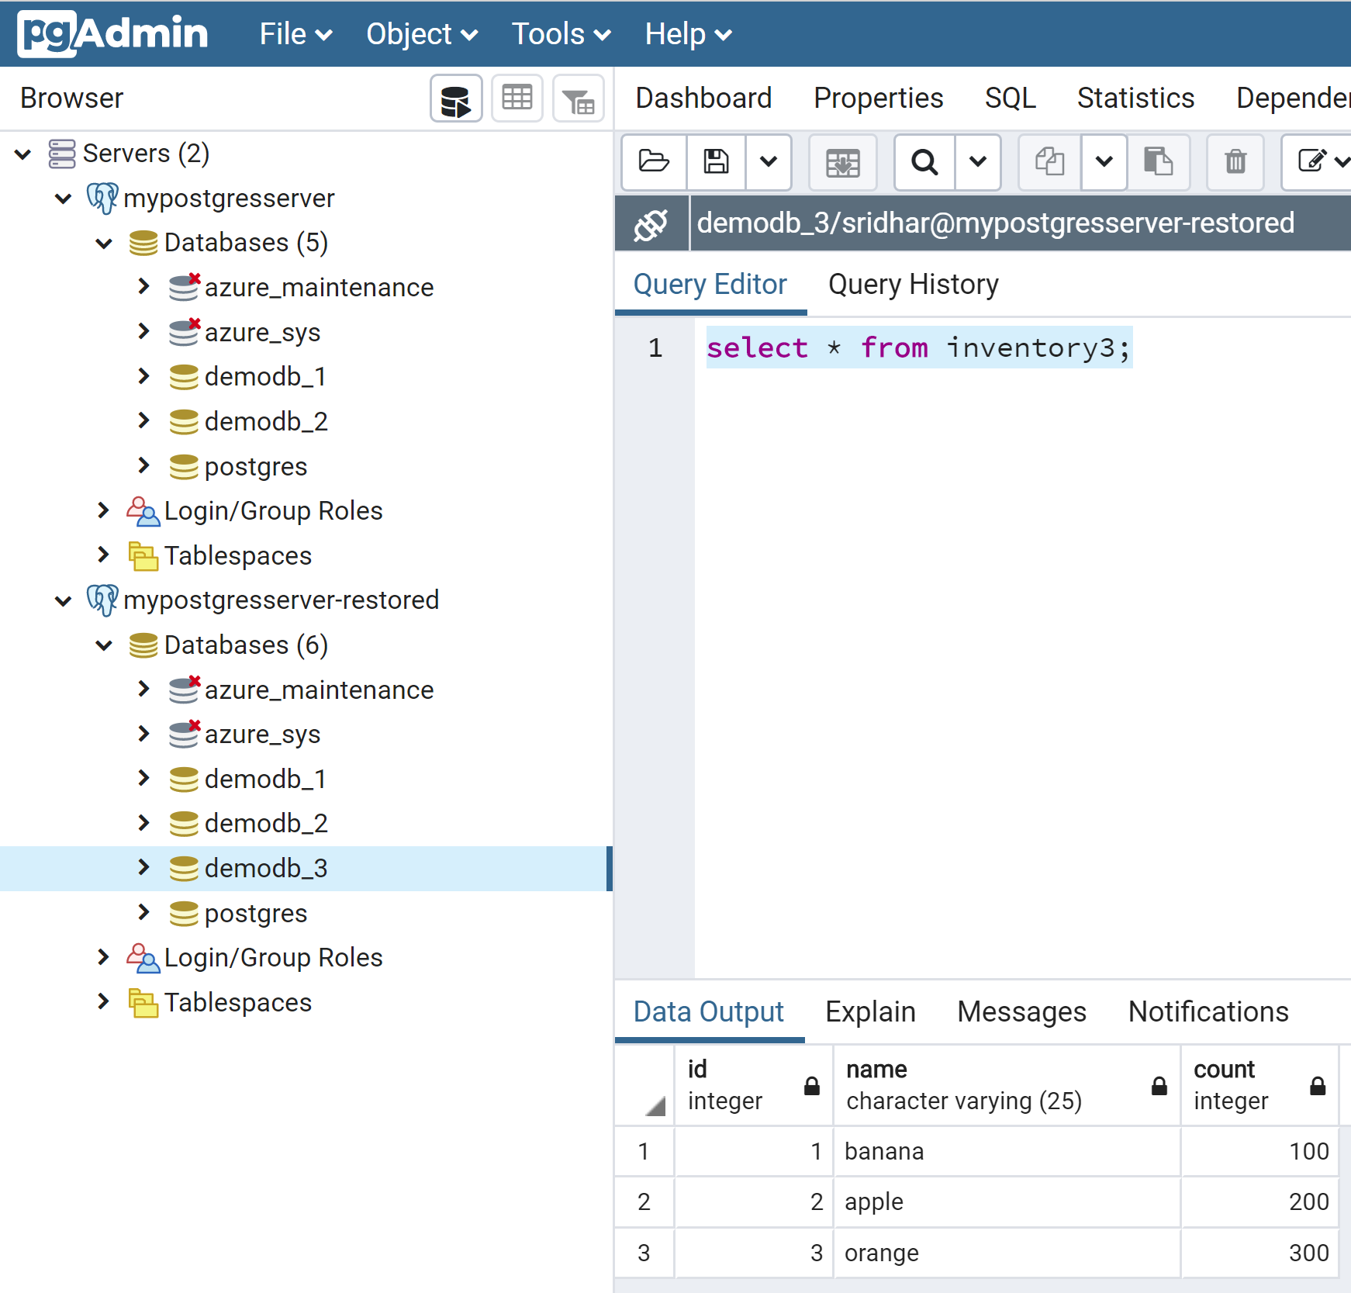
Verify data in restored server data is good
Server: mypostgresserver-restored
demodb_1
demodb_2
demodb_3

Slide 17
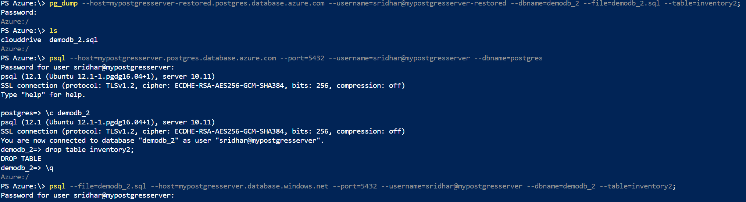
Restore the inventory2 table to demodb_2
Export the inventory2 table from demodb_2 database from mypostgresserver-restored server
pg_dump --host=mypostgresserver-restored.postgres.database.azure.com --username=sridhar@mypostgresserver-restored --dbname=demodb_2 --file=demodb_2.sql --table=inventory2;
Drop the table “inventory1” from mypostgresserver server
drop inventory2 from demodb_2
Import the inventory2 table to original server
psql --file=demodb_2.sql --host=mypostgresserver.database.windows.net --port=5432 --username=sridhar@mypostgresserver --dbname=demodb_2 --table=inventory2;

Slide 18
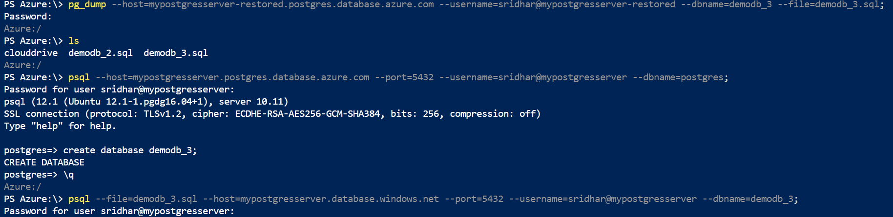
Restore the demodb_3 database
Export the demodb_3 database from mypostgresserver-restored server
pg_dump --host=mypostgresserver-restored.postgres.database.azure.com --username=sridhar@mypostgresserver-restored --dbname=demodb_3 --file=demodb_3.sql;
Create an empty database demodb_3 in mypostgresserver
create database demodb_3;
Import the demodb_3 to mypostgresserver server
psql --file=demodb_3.sql --host=mypostgresserver.database.windows.net --port=5432 --username=sridhar@mypostgresserver --dbname=demodb_3;

Slide 19
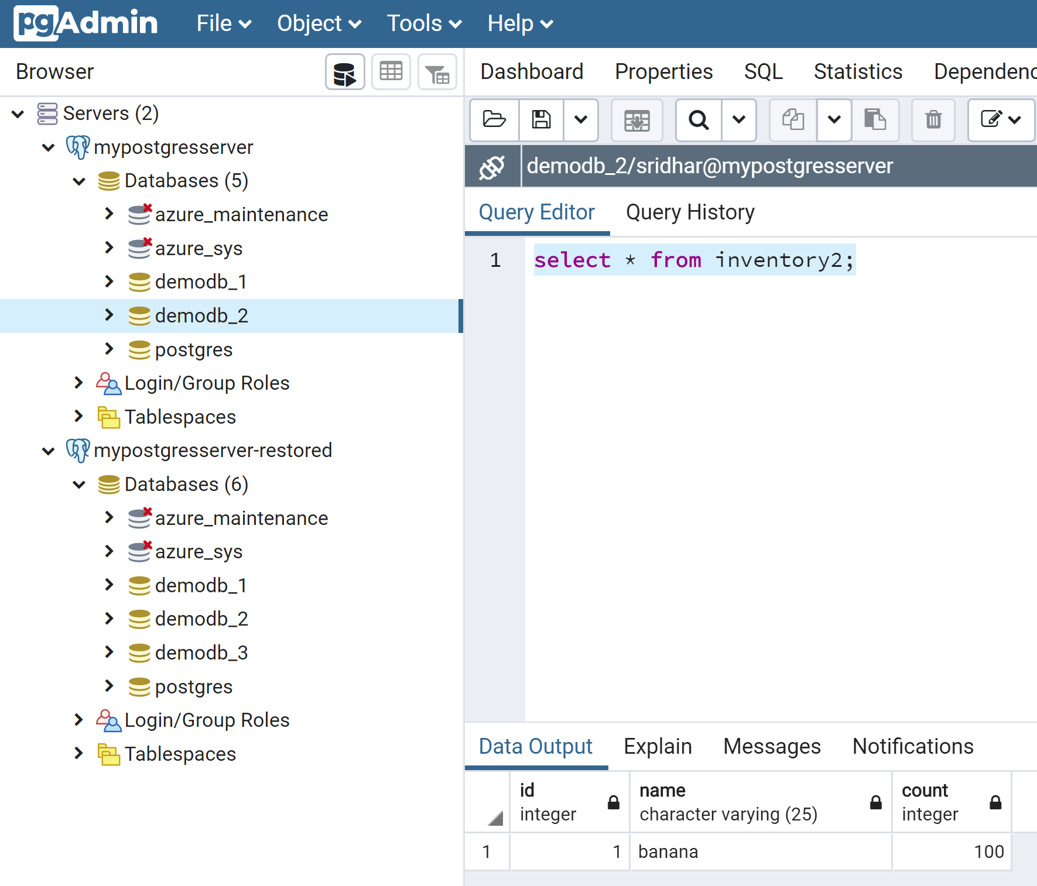
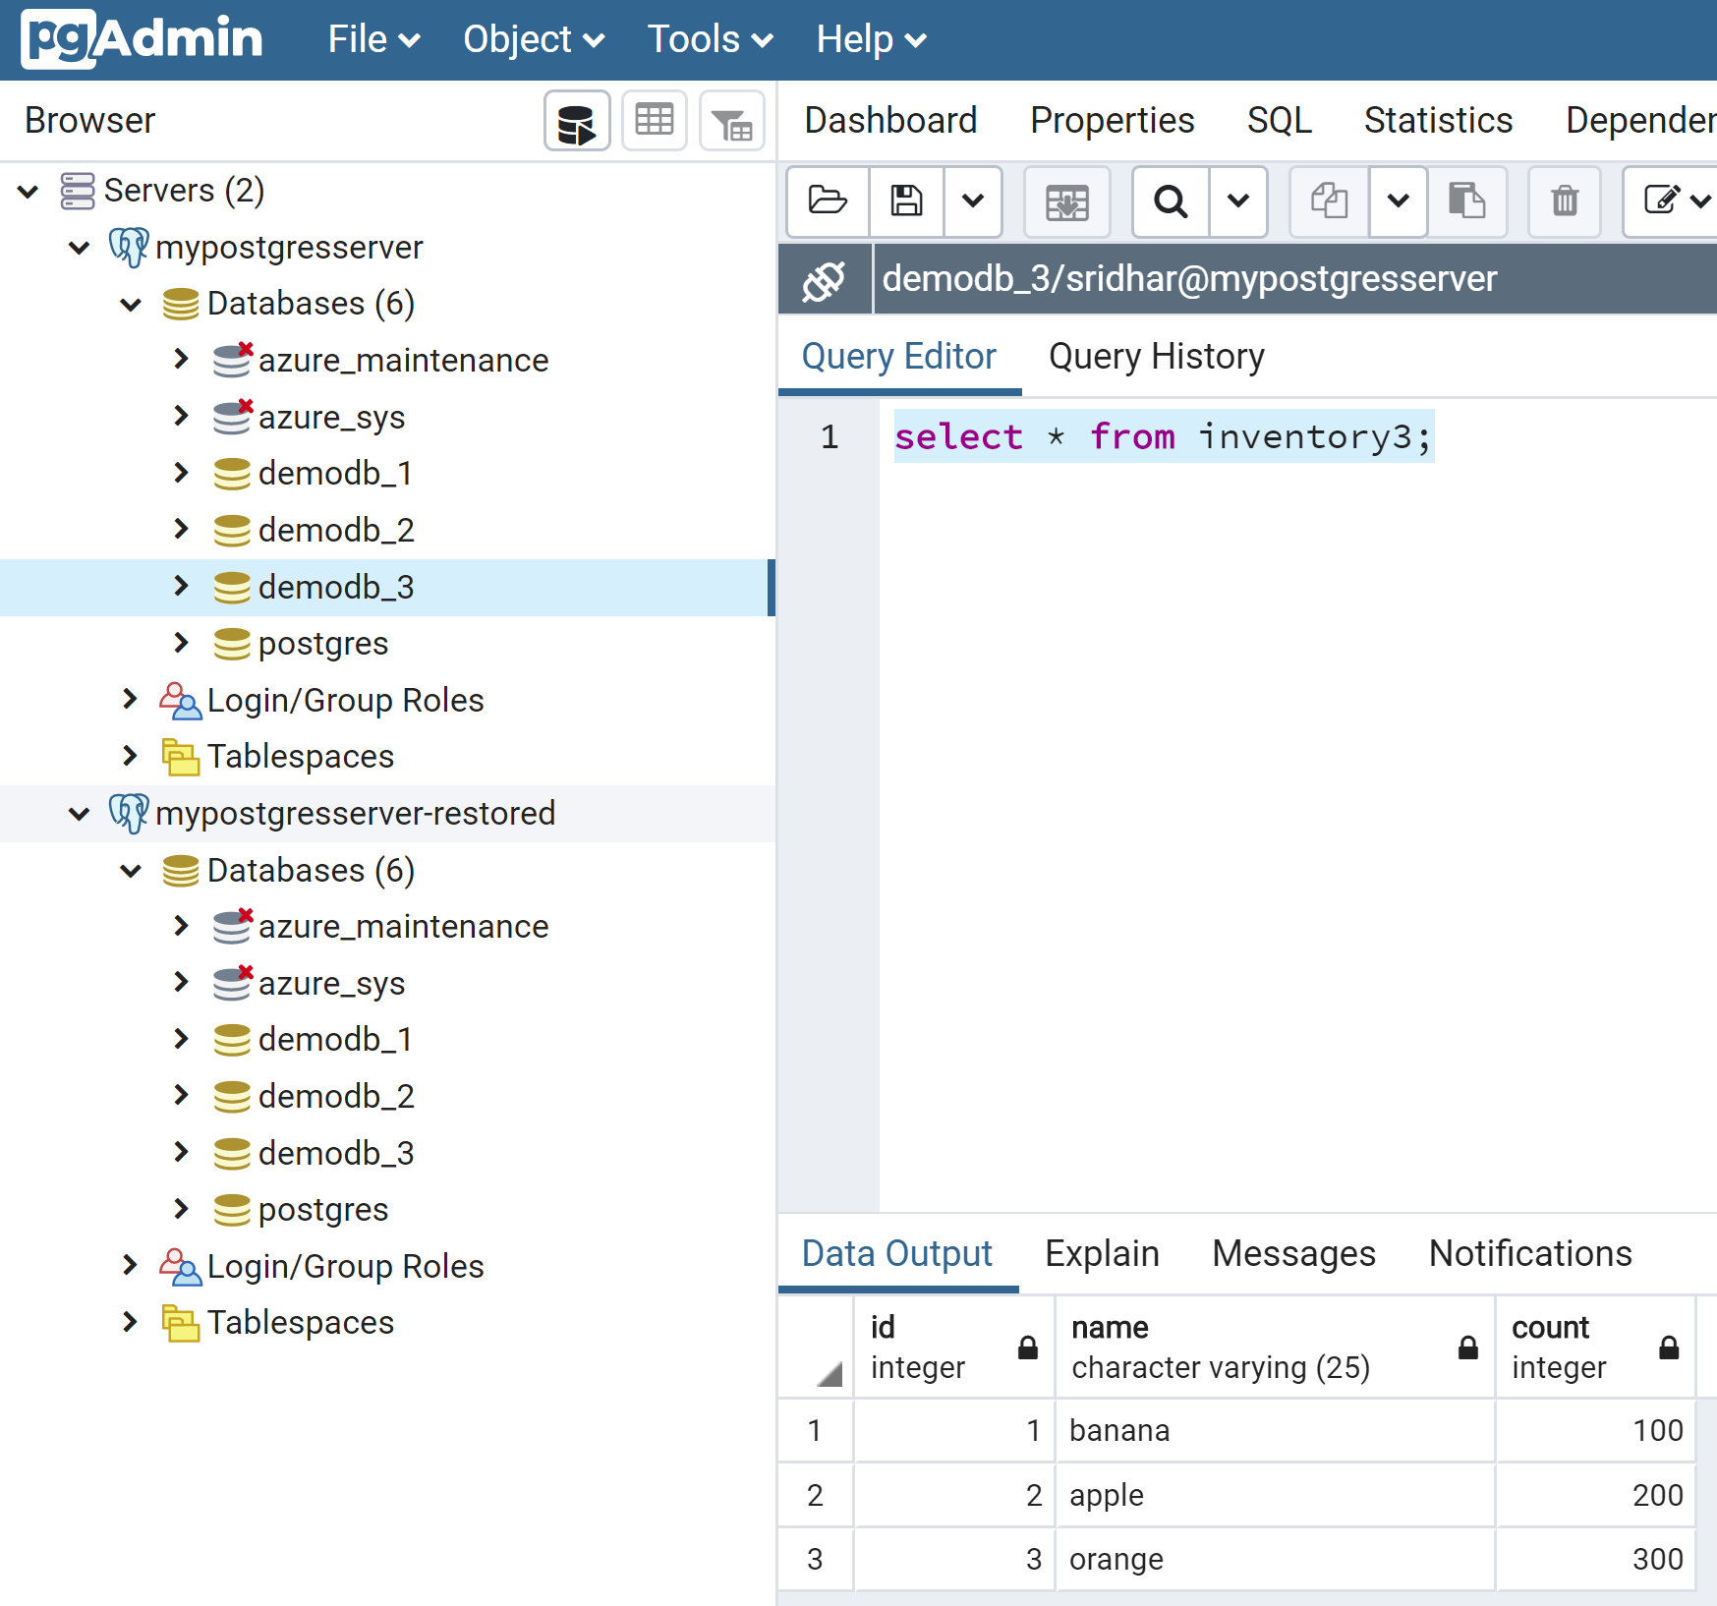
Verify the data on mypostgresserver after restore
demodb_2
demodb_3

Slide 20
Single server backup and restore using “Geo Redundant” backup option

Slide 21
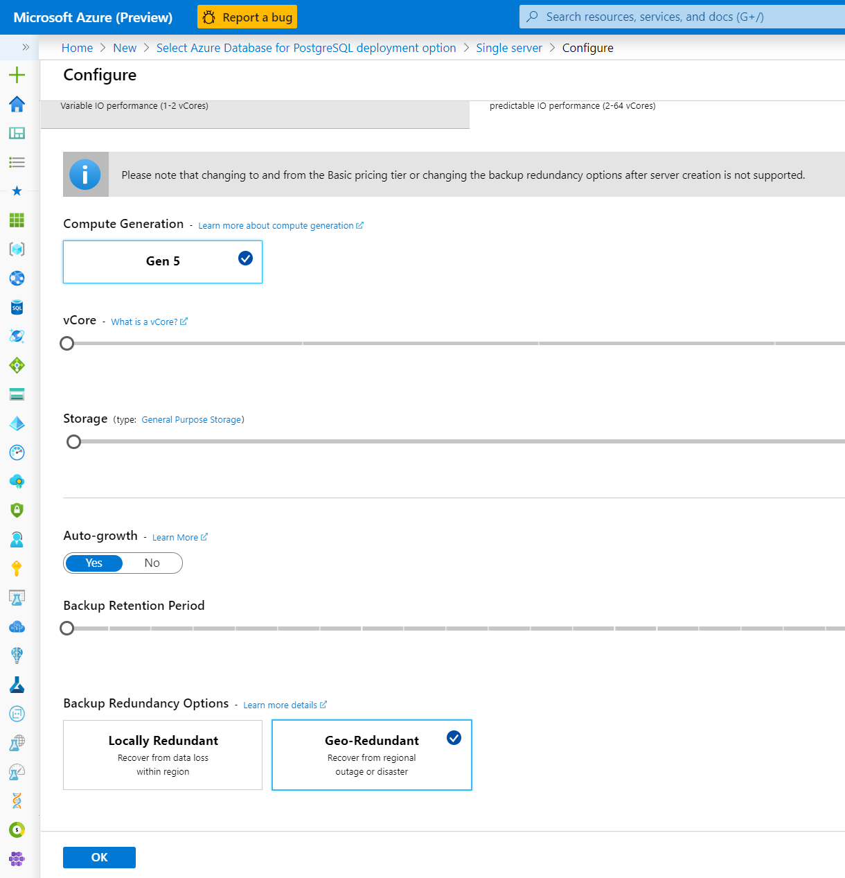
Pick the locally redundant server option
Click on configure server to choose backup option
Cannot be changed once server is created

Slide 22
Restore the server to a point-in-time
Restore the server in the same resource group as the backup
az postgres server georestore --resource-group demo --name mypostgresserver-georestored --source-server mypostgresserver --location eastus
Restore the server in a different resource group from the backup
az postgres server georestore --resource-group newresourcegroup --name mypostgresserver-georestored --source-server "/subscriptions/$<subscription ID>/resourceGroups/$<resource group ID>/providers/Microsoft.DBforPostgreSQL/servers/mypostgresserver" --location eastus

Slide 23
Q&A

Slide 24
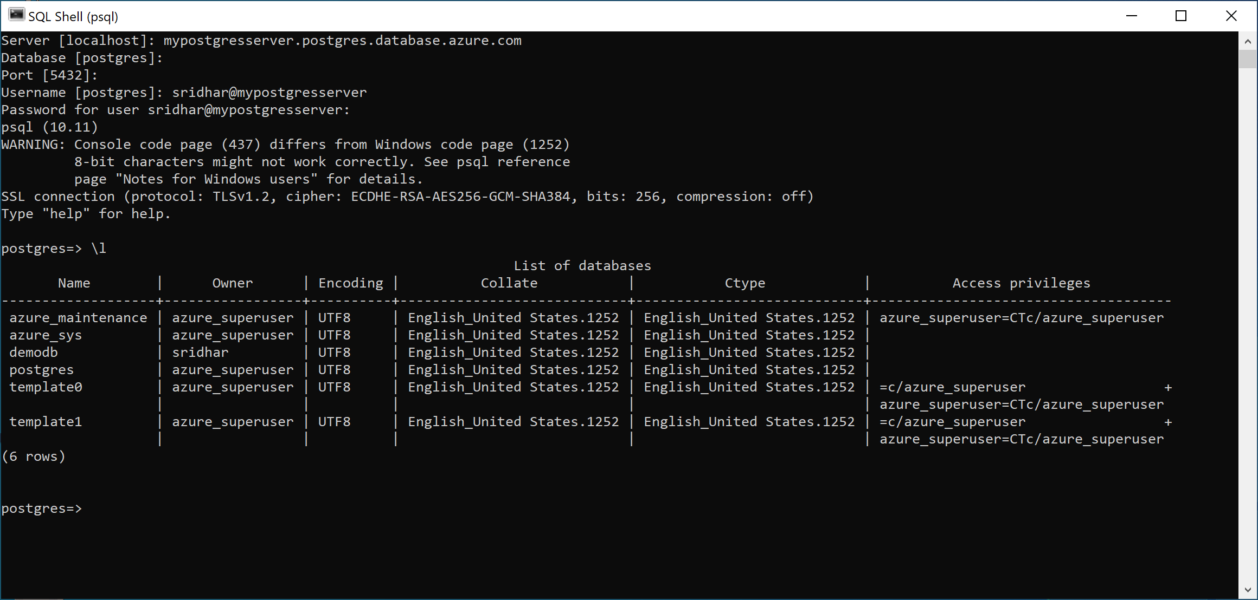
Connecting from a terminal

